Slide 1
High School Involvement Program
Scotty
Emma Rhane Napier
June 2015

Slide 2
Agenda
Design Process
Brainstorming and Research
Building Process
Final Design
Obstacles
Skills Learned
Time Management

Slide 3
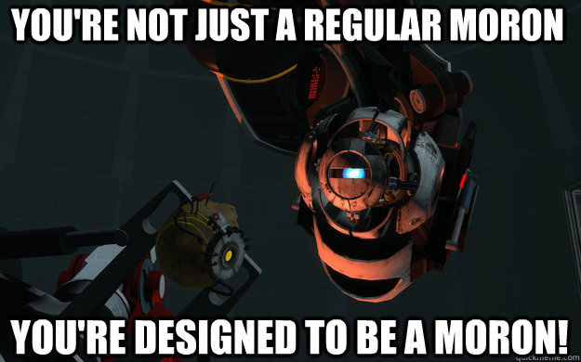
Design Process
Problem Statement: Build autonomous robot with verbal communication in a Scottish accent.

Slide 4
Brainstorming and Research
Design Concepts:
Locomotion:
Flying
Wheels
Walking
Speech
Personality
Limitations:
Cost
Weight
Schedule
Part compatibility
Research Topics:
Efficient robot kits
C based programming language
Comparing the different kits:
Arduino
Raspberry Pi
Library support: Arduino
Sound file players

Slide 5

Robot Overview
Brains
Sensors
Movement
Speech

Slide 6
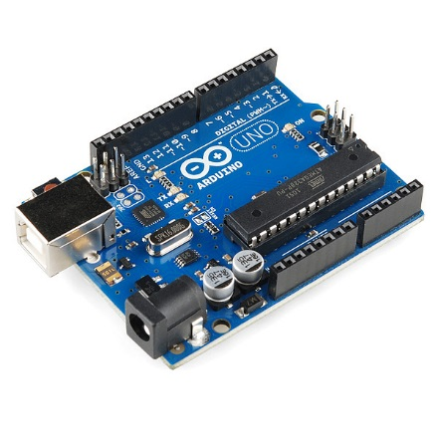
Brains
Started with Arduino Uno R3
Ended up with two
Sensors & Movement
Speech
Interacts autonomously with environment

Slide 7
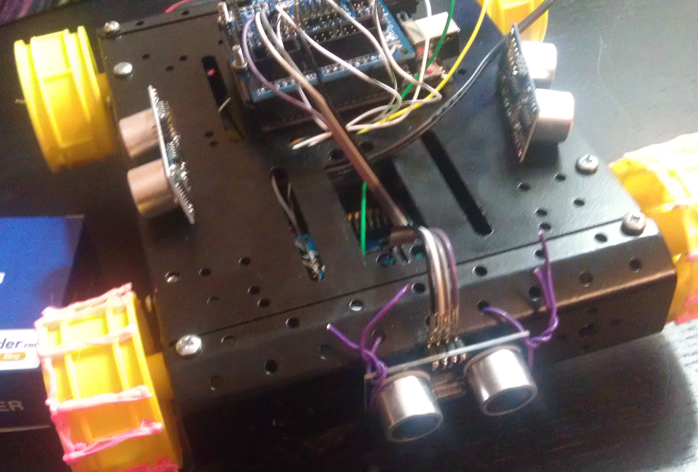
Eyes == Sensors
Three Ultrasonic Sensors
Sensors on Front, Left and Right side of chassis
Sensor sensitivity
Wiring
Environmental issues

Slide 8
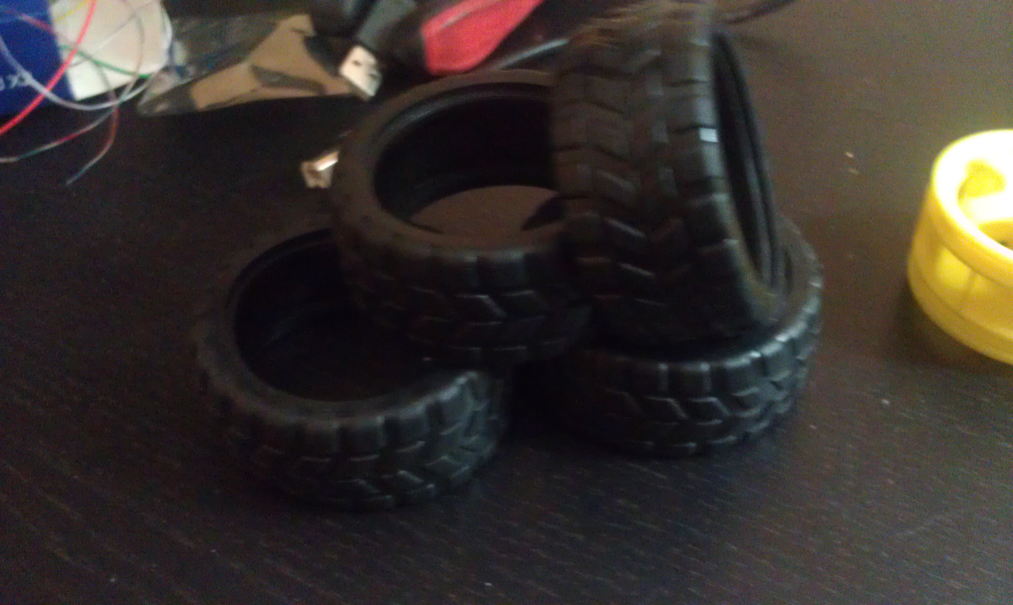
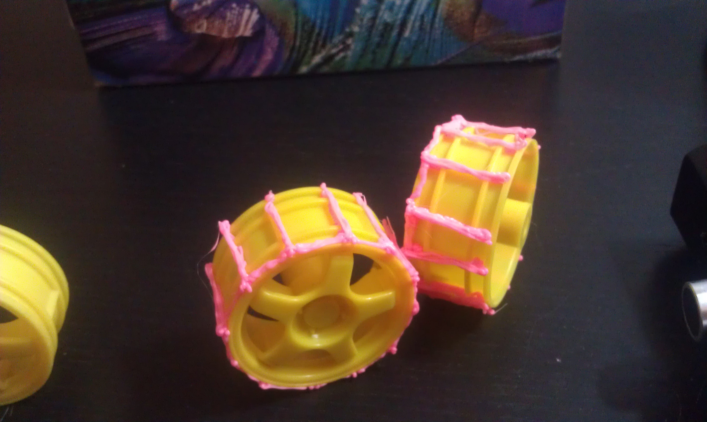
Movement
Four motors
Wiring problems
Problems faced:
“Real-World” testing
Weight of parts
PHYSICS
Final design

Slide 9
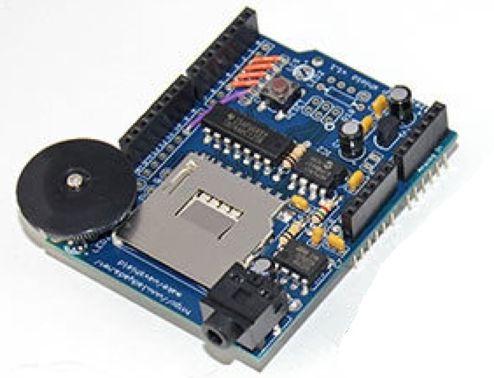
Speech
WaveShield
Library
Tutorial
Human speech capabilities
Headphone jack output and dial
Very quiet
.wav files

Slide 10
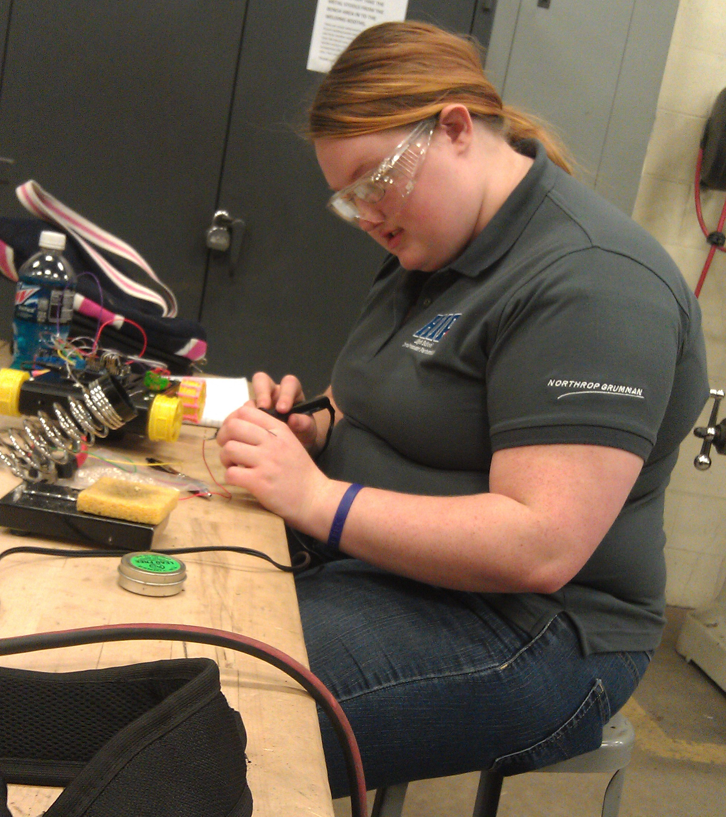
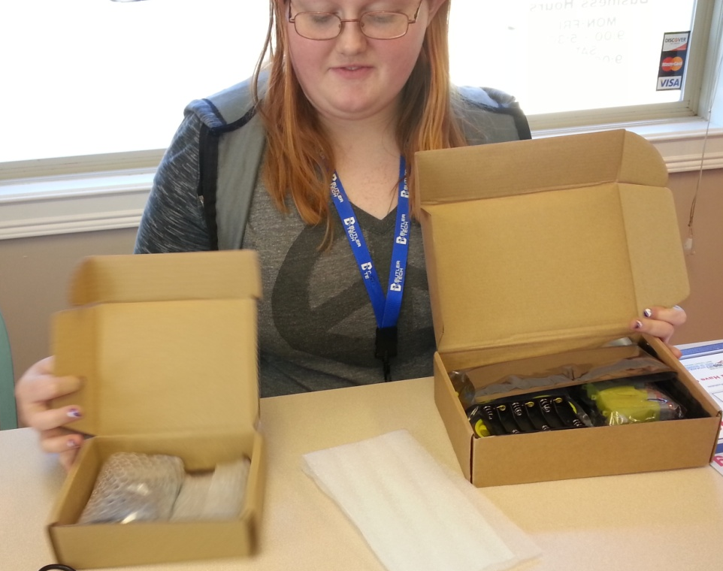
Building Process
DIY
Cost effective
Started with individual parts & pieces
Polarity problems
Color coding

Slide 11
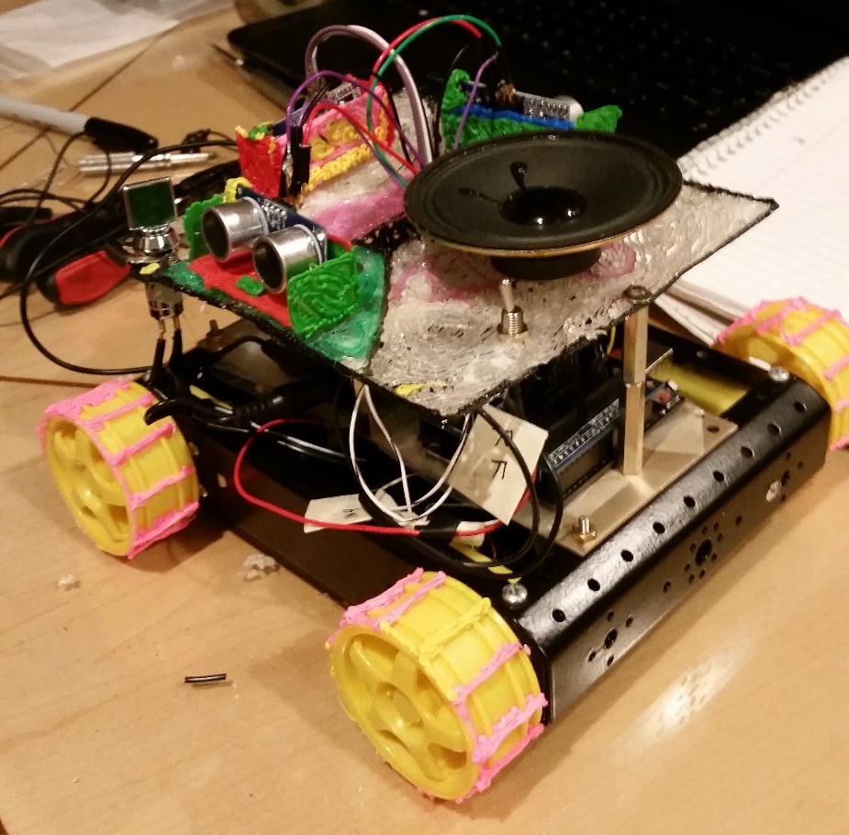
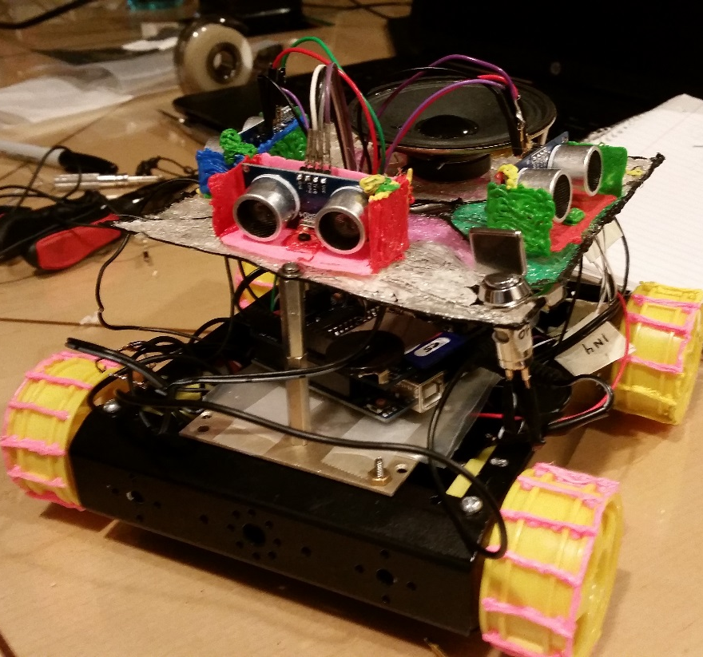
Final Design

Slide 12
Time Management
Sep – Ordered robot kit and began construction
Oct – Movement achieved
Nov – Battery pack . Auton started. Turning
Dec – Midpoint Update Presentations Prototyping different wheel configurations
Jan – Got more funding; got more parts. Set up github. Worked on code.
Feb – Worked on code. Extra sensors set up. Wave shield soldering started
Mar – Finished construction of waveshield. Tested the stacking
Apr – Fixed software library. Broke the waveshield. Order replacement part
May – Work on presentation. IT’S ALIVE.
Jun – Final Presentations

Slide 13
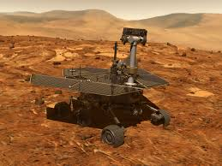
Obstacles Opportunities
Minimal coding knowledge going into HIP
Very horrendous at spelling
Random wire disconnection and intermittent connections
Motors were insufficient
Eli smash
Supply chain management
Lack of actual instructions

Slide 14
Skills Learned
Greater comprehension of Arduino C programming language
Soldering
Resumé building
Presentation designing
Robotics
Product integration
Debug wiring/coding
Communication
Source code management
Time management
Lab Safety

Slide 15
Future Schemes
Microphone Pack Integration
Humanized interaction and conversation
Stronger motors and new hand-made custom chassis

Slide 16
Questions?

Slide 18
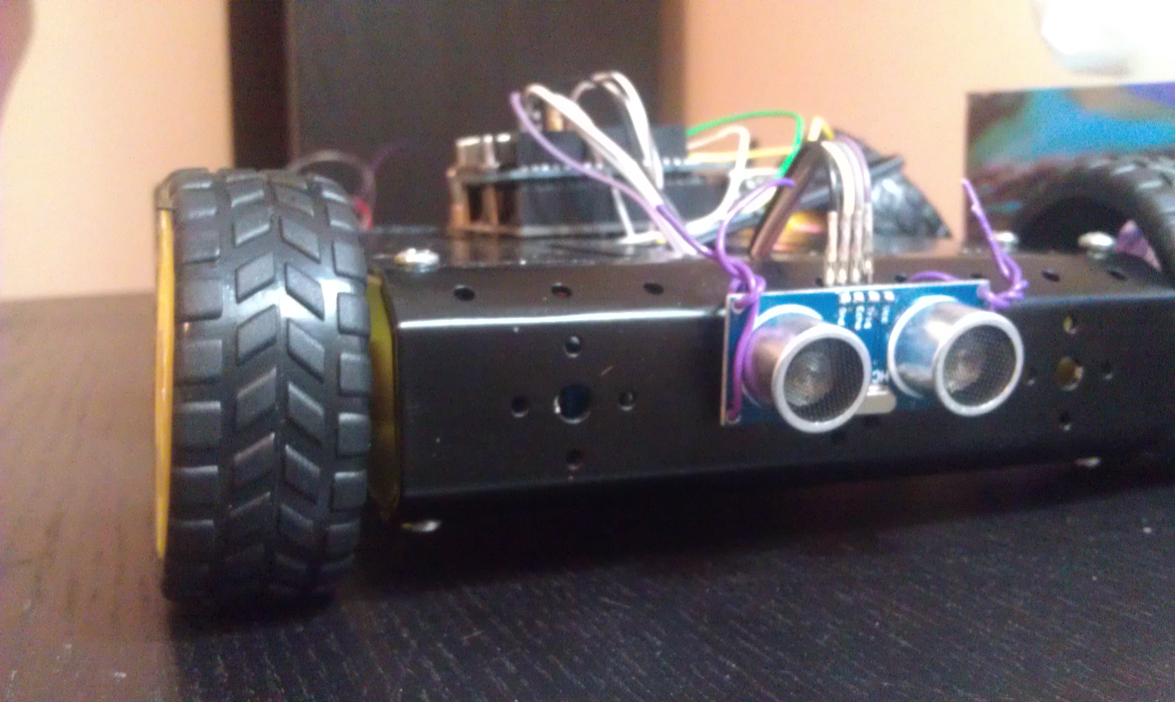
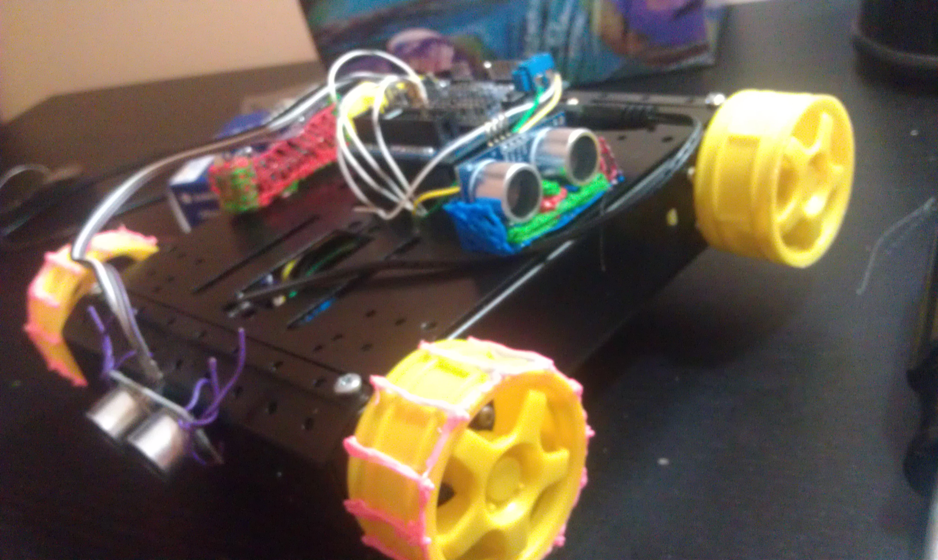
Extra Pictures

Slide 19
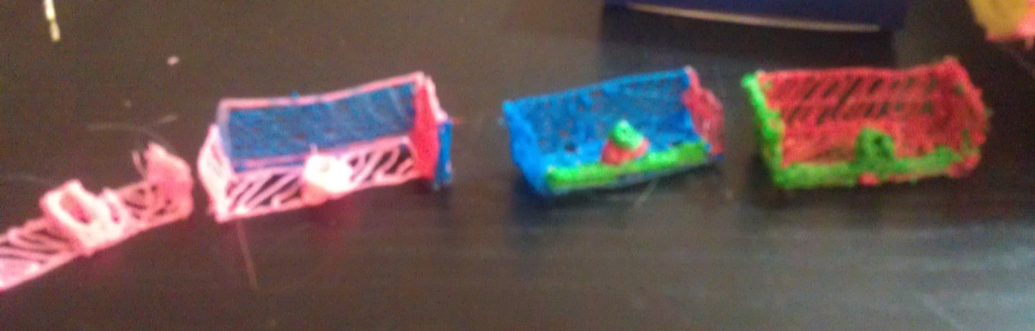
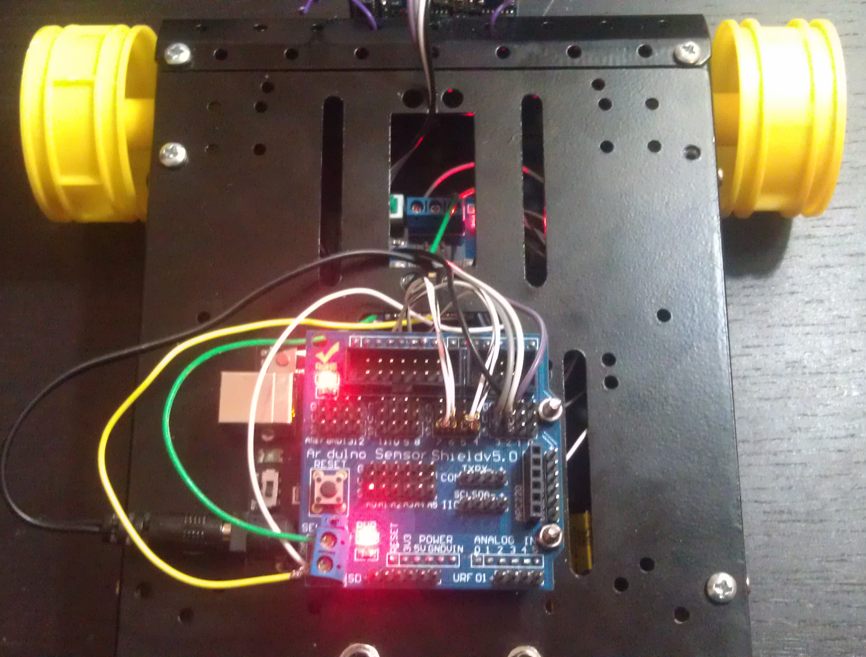
Extra Pictures

